Slide 1
President’s Report 23 February 2017

Slide 2
Intercampus Faculty Council (IFC)
IFC is meets tomorrow, 24 Feb 17, via telepresence
Review of Board enacted CR&Rs
Minimum of 10 Title IX faculty panelists
Minimum 20 nominees by the Senate
Chancellor selects minimum 10 to be trained panelists
Annual appointments and not 3 year
Will set up appointments as part of Senate committee actions (at April meeting)

Slide 3
CR&R Changes
Diversity and Inclusion Audit Changes
Approved by IFC
Were approved by the Board of Curators at 9-10 Feb meeting at Mizzou
Take effect 1 March 2017
Post Tenure Review
Approved by IFC (11-0-1)
Now in review by UM Legal
Preparation for enacting Fall semester – Workload Policy
Faculty Standard of Conduct
To be considered for feedback and approval at IFC

Slide 4
President Designate Choi Campus Visit
6 February 2017
Morning meeting ~ 80 – 100 attendees
Afternoon meeting ~ 140 – 160 attendees

Slide 5
Faculty Grievances Per CR&R 370.010
Five faculty grievances filed in 6 months
CR&R allows 2 committee structures
Model A: Two (or four) GRP faculty members (plus 2 alternates) chosen by Faculty Senate
Model B: The GRP will consist of two panels as described in Model A above
Issues with small committee and large case load
Time
Consideration to details
Suggestion to begin a Model B structure

Slide 6
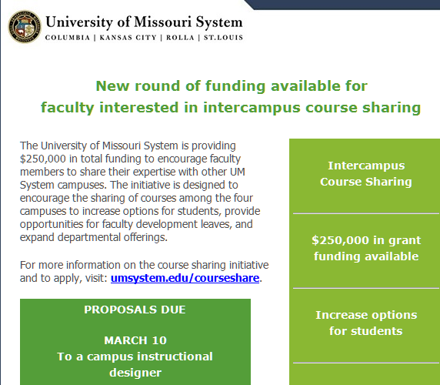
Shared Course Proposals Due

Slide 7
Transit Feasibility Study
5-month study on transit possibilities
Campus and/or community, e.g., eBus
Study to conclude by the end of May 2017
HNTB consultants , campus contact:
Ted Ruth (truth@mst.edu)
Seeking input from faculty, staff, students, and community
Transportation survey available at: https://www.surveymonkey.com/r/msttransitstudy

